Slide 1
Software Testing Strategies
A strategic approach to testing
Test strategies for conventional software
Test strategies for object-oriented software
Validation testing
System testing
The art of debugging

Slide 2
Introduction
A strategy for software testing integrates the design of software test cases into a well-planned series of steps that result in successful development of the software
The strategy provides a road map that describes the steps to be taken, when, and how much effort, time, and resources will be required
The strategy incorporates test planning, test case design, test execution, and test result collection and evaluation
The strategy provides guidance for the practitioner and a set of milestones for the manager
Because of time pressures, progress must be measurable and problems must surface as early as possible

Slide 3
A Strategic Approach to Testing

Slide 4
General Characteristics of Strategic Testing
To perform effective testing, a software team should conduct effective formal technical reviews
Testing begins at the component level and work outward toward the integration of the entire computer-based system
Different testing techniques are appropriate at different points in time
Testing is conducted by the developer of the software and (for large projects) by an independent test group
Testing and debugging are different activities, but debugging must be accommodated in any testing strategy

Slide 5
Verification and Validation
Software testing is part of a broader group of activities called verification and validation that are involved in software quality assurance
Verification (Are the algorithms coded correctly?)
The set of activities that ensure that software correctly implements a specific function or algorithm
Validation (Does it meet user requirements?)
The set of activities that ensure that the software that has been built is traceable to customer requirements

Slide 6
Organizing for Software Testing
Testing should aim at "breaking" the software
Common misconceptions
The developer of software should do no testing at all
The software should be given to a secret team of testers who will test it unmercifully
The testers get involved with the project only when the testing steps are about to begin
Reality: Independent test group
Removes the inherent problems associated with letting the builder test the software that has been built
Removes the conflict of interest that may otherwise be present
Works closely with the software developer during analysis and design to ensure that thorough testing occurs

Slide 7
A Strategy for Testing Conventional Software
System Testing
Narrow to
Broader scope
Validation Testing
Integration Testing
Unit Testing
Code
Abstract to
concrete
Design
Requirements
System Engineering

Slide 8
Levels of Testing for Conventional Software
Unit testing
Concentrates on each component/function of the software as implemented in the source code
Integration testing
Focuses on the design and construction of the software architecture
Validation testing
Requirements are validated against the constructed software
System testing
The software and other system elements are tested as a whole

Slide 9
Testing Strategy applied to Conventional Software
Unit testing
Exercises specific paths in a component's control structure to ensure complete coverage and maximum error detection
Components are then assembled and integrated
Integration testing
Focuses on inputs and outputs, and how well the components fit together and work together
Validation testing
Provides final assurance that the software meets all functional, behavioral, and performance requirements
System testing
Verifies that all system elements (software, hardware, people, databases) mesh properly and that overall system function and performance is achieved

Slide 10
Testing Strategy applied to Object-Oriented Software
Testing classes is a fundamentally different problem than testing functions. A function (or a procedure) has a clearly defined input-output behavior, while a class does not have an input-output behavior specification. We can test a method of a class using approaches for testing functions, but we cannot test the class using these approaches. Must broaden testing to include detections of errors in analysis and design models
Unit testing loses some of its meaning and integration testing changes significantly
Use the same philosophy but different approach as in conventional software testing
Test "in the small" and then work out to testing "in the large"
Testing in the small involves class attributes and operations; the main focus is on communication and collaboration within the class
Testing in the large involves a series of regression tests to uncover errors due to communication and collaboration among classes
Finally, the system as a whole is tested to detect errors in fulfilling requirements

Slide 11
Techniques of object-oriented testing are as follows:
Fault Based Testing:
This type of checking permits for coming up with test cases supported the consumer specification or the code or both. It tries to identify possible faults (areas of design or code that may lead to errors.). For all of these faults, a test case is developed to “flush” the errors out. These tests also force each time of code to be executed.
This method of testing does not find all types of errors. However, incorrect specification and interface errors can be missed. These types of errors can be uncovered by function testing in the traditional testing model. In the object-oriented model, interaction errors can be uncovered by scenario-based testing. This form of Object oriented-testing can only test against the client’s specifications, so interface errors are still missed.

Slide 12
Class Testing Based on Method Testing This approach is the simplest approach to test classes. Each method of the class performs a well defined cohesive function and can, therefore, be related to unit testing of the traditional testing techniques. Therefore all the methods of a class can be involved at least once to test the class.

Slide 13
Random Testing: It is supported by developing a random test sequence that tries the minimum variety of operations typical to the behavior of the categories
Partition Testing: This methodology categorizes the inputs and outputs of a category so as to check them severely. This minimizes the number of cases that have to be designed.
Scenario-based Testing: It primarily involves capturing the user actions then stimulating them to similar actions throughout the test. These tests tend to search out interaction form of error.

Slide 14
When is Testing Complete?
There is no definitive answer to this question
Every time a user executes the software, the program is being tested
Sadly, testing usually stops when a project is running out of time, money, or both
One approach is to divide the test results into various severity levels
Then consider testing to be complete when certain levels of errors no longer occur or have been repaired or eliminated

Slide 15
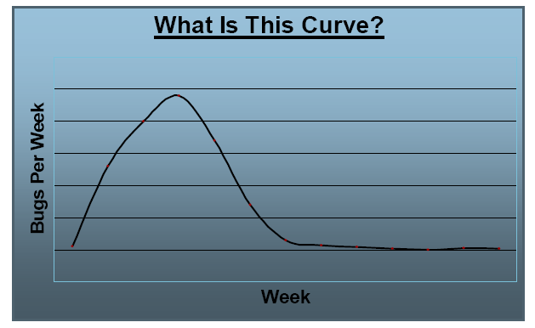
The Bug Curve

Slide 16
[1] Class (Unit) Testing
Smallest testable unit is the encapsulated class
Test each operation as part of a class hierarchy because its class hierarchy defines its context of use
Approach:
Test each method (and constructor) within a class
Test the state behavior (attributes) of the class between methods
How is class testing different from conventional testing?
Conventional testing focuses on input-process-output, whereas class testing focuses on each method, then designing sequences of methods to exercise states of a class
But white-box testing can still be applied

Slide 17
Class Testing Process
How to test?
class
to be
tested
results
software
engineer
test cases
Why a loop?

Slide 18
Class Test Case Design
Identify each test case uniquely - Associate test case explicitly with the class and/or method to be tested
State the purpose of the test
Each test case should contain:
A list of messages and operations that will be exercised as a consequence of the test
A list of exceptions that may occur as the object is tested
A list of external conditions for setup (i.e., changes in the environment external to the software that must exist in order to properly conduct the test)
Supplementary information that will aid in understanding or implementing the test
Automated unit testing tools facilitate these requirements

Slide 19
Challenges of Class Testing
Encapsulation:
Difficult to obtain a snapshot of a class without building extra methods which display the classes’ state
Inheritance and polymorphism:
Each new context of use (subclass) requires re-testing because a method may be implemented differently (polymorphism).
Other unaltered methods within the subclass may use the redefined method and need to be tested
White box tests:
Basis path, condition, data flow and loop tests can all apply to individual methods, but don’t test interactions between methods

Slide 20
Random Class Testing
Identify methods applicable to a class
Define constraints on their use – e.g. the class must always be initialized first
Identify a minimum test sequence – an operation sequence that defines the minimum life history of the class
Generate a variety of random (but valid) test sequences – this exercises more complex class instance life histories
Example:
An account class in a banking application has open, setup, deposit, withdraw, balance, summarize and close methods
The account must be opened first and closed on completion
Open – setup – deposit – withdraw – close
Open – setup – deposit –* [deposit | withdraw | balance | summarize] – withdraw – close. Generate random test sequences using this template

Slide 21
[2] Integration Testing
OO does not have a hierarchical control structure so conventional top-down and bottom-up integration tests have little meaning
Integration applied three different incremental strategies:
Thread-based testing: integrates classes required to respond to one input or event
Use-based testing: integrates classes required by one use case
Cluster testing: integrates classes required to demonstrate one collaboration
What integration testing strategies will you use?

Slide 22
Random Integration Testing
Multiple Class Random Testing
For each client class, use the list of class methods to generate a series of random test sequences. Methods will send messages to other server classes.
For each message that is generated, determine the collaborating class and the corresponding method in the server object.
For each method in the server object (that has been invoked by messages sent from the client object), determine the messages that it transmits
For each of the messages, determine the next level of methods that are invoked and incorporate these into the test sequence

Slide 23
[3] Validation Testing
Are we building the right product?
Validation succeeds when software functions in a manner that can be reasonably expected by the customer.
Focus on user-visible actions and user-recognizable outputs
Details of class connections disappear at this level
Apply:
Use-case scenarios from the software requirements spec
Black-box testing to create a deficiency list
Acceptance tests through alpha (at developer’s site) and beta (at customer’s site) testing with actual customers
How will you validate your term product?

Slide 24
[4] System Testing
Software may be part of a larger system. This often leads to “finger pointing” by other system dev teams
Finger pointing defence:
Desierror-handling paths that test external information
Conduct a series of tests that simulate gn bad data
Record the results of tests to use as evidence
Types of System Testing:
Recovery testing: how well and quickly does the system recover from faults
Security testing: verify that protection mechanisms built into the system will protect from unauthorized access (hackers, disgruntled employees, fraudsters)
Stress testing: place abnormal load on the system
Performance testing: investigate the run-time performance within the context of an integrated system

Slide 25
Ensuring a Successful Software Test Strategy
Specify product requirements in a quantifiable manner long before testing commences
State testing objectives explicitly in measurable terms
Understand the user of the software (through use cases) and develop a profile for each user category
Develop a testing plan that emphasizes rapid cycle testing to get quick feedback to control quality levels and adjust the test strategy
Build robust software that is designed to test itself and can diagnose certain kinds of errors
Use effective formal technical reviews as a filter prior to testing to reduce the amount of testing required
Conduct formal technical reviews to assess the test strategy and test cases themselves
Develop a continuous improvement approach for the testing process through the gathering of metrics

Slide 26
Test Strategies for Conventional Software

Slide 27
Unit Testing
Focuses testing on the function or software module
Concentrates on the internal processing logic and data structures
Is simplified when a module is designed with high cohesion
Reduces the number of test cases
Allows errors to be more easily predicted and uncovered
Concentrates on critical modules and those with high cyclomatic complexity when testing resources are limited

Slide 28
Targets for Unit Test Cases
Module interface
Ensure that information flows properly into and out of the module
Local data structures
Ensure that data stored temporarily maintains its integrity during all steps in an algorithm execution
Boundary conditions
Ensure that the module operates properly at boundary values established to limit or restrict processing
Independent paths (basis paths)
Paths are exercised to ensure that all statements in a module have been executed at least once
Error handling paths
Ensure that the algorithms respond correctly to specific error conditions

Slide 29
Common Computational Errors in Execution Paths
Misunderstood or incorrect arithmetic precedence
Mixed mode operations (e.g., int, float, char)
Incorrect initialization of values
Precision inaccuracy and round-off errors
Incorrect symbolic representation of an expression (int vs. float)

Slide 30
Other Errors to Uncover
Comparison of different data types
Incorrect logical operators or precedence
Expectation of equality when precision error makes equality unlikely (using == with float types)
Incorrect comparison of variables
Improper or nonexistent loop termination
Failure to exit when divergent iteration is encountered
Improperly modified loop variables
Boundary value violations

Slide 31
Problems to uncover in Error Handling
Error description is unintelligible or ambiguous
Error noted does not correspond to error encountered
Error condition causes operating system intervention prior to error handling
Exception condition processing is incorrect
Error description does not provide enough information to assist in the location of the cause of the error

Slide 32
Drivers and Stubs for Unit Testing
Driver
A simple main program that accepts test case data, passes such data to the component being tested, and prints the returned results
Stubs
Serve to replace modules that are subordinate to (called by) the component to be tested
It uses the module’s exact interface, may do minimal data manipulation, provides verification of entry, and returns control to the module undergoing testing
Drivers and stubs both represent overhead
Both must be written but don’t constitute part of the installed software product

Slide 33
Integration Testing
Defined as a systematic technique for constructing the software architecture
At the same time integration is occurring, conduct tests to uncover errors associated with interfaces
Objective is to take unit tested modules and build a program structure based on the prescribed design
Two Approaches
Non-incremental Integration Testing
Incremental Integration Testing

Slide 34
Non-incremental Integration Testing
Commonly called the “Big Bang” approach
All components are combined in advance
The entire program is tested as a whole
Chaos results
Many seemingly-unrelated errors are encountered
Correction is difficult because isolation of causes is complicated
Once a set of errors are corrected, more errors occur, and testing appears to enter an endless loop

Slide 35
Incremental Integration Testing
Three kinds
Top-down integration
Bottom-up integration
Sandwich integration
The program is constructed and tested in small increments
Errors are easier to isolate and correct
Interfaces are more likely to be tested completely
A systematic test approach is applied

Slide 36
Top-down Integration
Modules are integrated by moving downward through the control hierarchy, beginning with the main module
Subordinate modules are incorporated in either a depth-first or breadth-first fashion
DF: All modules on a major control path are integrated
BF: All modules directly subordinate at each level are integrated
Advantages
This approach verifies major control or decision points early in the test process
Disadvantages
Stubs need to be created to substitute for modules that have not been built or tested yet; this code is later discarded
Because stubs are used to replace lower level modules, no significant data flow can occur until much later in the integration/testing process

Slide 37
Bottom-up Integration
Integration and testing starts with the most atomic modules in the control hierarchy
Advantages
This approach verifies low-level data processing early in the testing process
Need for stubs is eliminated
Disadvantages
Driver modules need to be built to test the lower-level modules; this code is later discarded or expanded into a full-featured version
Drivers inherently do not contain the complete algorithms that will eventually use the services of the lower-level modules; consequently, testing may be incomplete or more testing may be needed later when the upper level modules are available

Slide 38
Sandwich Integration
Consists of a combination of both top-down and bottom-up integration
Occurs both at the highest level modules and also at the lowest level modules
Proceeds using functional groups of modules, with each group completed before the next
High and low-level modules are grouped based on the control and data processing they provide for a specific program feature
Integration within the group progresses in alternating steps between the high and low level modules of the group
When integration for a certain functional group is complete, integration and testing moves onto the next group
Reaps the advantages of both types of integration while minimizing the need for drivers and stubs
Requires a disciplined approach so that integration doesn’t tend towards the “big bang” scenario

Slide 39
Regression Testing
Each new addition or change to baselined software may cause problems with functions that previously worked flawlessly
Regression testing re-executes a small subset of tests that have already been conducted
Ensures that changes have not propagated unintended side effects
Helps to ensure that changes do not introduce unintended behavior or additional errors
May be done manually or through the use of automated capture/playback tools
Regression test suite contains three different classes of test cases
A representative sample of tests that will exercise all software functions
Additional tests that focus on software functions that are likely to be affected by the change
Tests that focus on the actual software components that have been changed

Slide 40
Smoke Testing
Taken from the world of hardware
Power is applied and a technician checks for sparks, smoke, or other dramatic signs of fundamental failure
Designed as a pacing mechanism for time-critical projects
Allows the software team to assess its project on a frequent basis
Includes the following activities
The software is compiled and linked into a build
A series of breadth tests is designed to expose errors that will keep the build from properly performing its function
The goal is to uncover “show stopper” errors that have the highest likelihood of throwing the software project behind schedule
The build is integrated with other builds and the entire product is smoke tested daily
Daily testing gives managers and practitioners a realistic assessment of the progress of the integration testing
After a smoke test is completed, detailed test scripts are executed

Slide 41
Benefits of Smoke Testing
Integration risk is minimized
Daily testing uncovers incompatibilities and show-stoppers early in the testing process, thereby reducing schedule impact
The quality of the end-product is improved
Smoke testing is likely to uncover both functional errors and architectural and component-level design errors
Error diagnosis and correction are simplified
Smoke testing will probably uncover errors in the newest components that were integrated
Progress is easier to assess
As integration testing progresses, more software has been integrated and more has been demonstrated to work
Managers get a good indication that progress is being made

Slide 42
Test Strategies for Object-Oriented Software

Slide 43
Test Strategies for Object-Oriented Software
With object-oriented software, you can no longer test a single operation in isolation (conventional thinking)
Traditional top-down or bottom-up integration testing has little meaning
Class testing for object-oriented software is the equivalent of unit testing for conventional software
Focuses on operations encapsulated by the class and the state behavior of the class
Drivers can be used
To test operations at the lowest level and for testing whole groups of classes
To replace the user interface so that tests of system functionality can be conducted prior to implementation of the actual interface
Stubs can be used
In situations in which collaboration between classes is required but one or more of the collaborating classes has not yet been fully implemented

Slide 44
Test Strategies for Object-Oriented Software (continued)
Two different object-oriented testing strategies
Thread-based testing
Integrates the set of classes required to respond to one input or event for the system
Each thread is integrated and tested individually
Regression testing is applied to ensure that no side effects occur
Use-based testing
First tests the independent classes that use very few, if any, server classes
Then the next layer of classes, called dependent classes, are integrated
This sequence of testing layer of dependent classes continues until the entire system is constructed

Slide 45
Validation Testing

Slide 46
Background
Validation testing follows integration testing
The distinction between conventional and object-oriented software disappears
Focuses on user-visible actions and user-recognizable output from the system
Demonstrates conformity with requirements
Designed to ensure that
All functional requirements are satisfied
All behavioral characteristics are achieved
All performance requirements are attained
Documentation is correct
Usability and other requirements are met (e.g., transportability, compatibility, error recovery, maintainability)
After each validation test
The function or performance characteristic conforms to specification and is accepted
A deviation from specification is uncovered and a deficiency list is created
A configuration review or audit ensures that all elements of the software configuration have been properly developed, cataloged, and have the necessary detail for entering the support phase of the software life cycle

Slide 47
Alpha and Beta Testing
Alpha testing
Conducted at the developer’s site by end users
Software is used in a natural setting with developers watching intently
Testing is conducted in a controlled environment
Beta testing
Conducted at end-user sites
Developer is generally not present
It serves as a live application of the software in an environment that cannot be controlled by the developer
The end-user records all problems that are encountered and reports these to the developers at regular intervals
After beta testing is complete, software engineers make software modifications and prepare for release of the software product to the entire customer base

Slide 48
System Testing

Slide 49
Different Types
Recovery testing
Tests for recovery from system faults
Forces the software to fail in a variety of ways and verifies that recovery is properly performed
Tests reinitialization, checkpointing mechanisms, data recovery, and restart for correctness
Security testing
Verifies that protection mechanisms built into a system will, in fact, protect it from improper access
Stress testing
Executes a system in a manner that demands resources in abnormal quantity, frequency, or volume
Performance testing
Tests the run-time performance of software within the context of an integrated system
Often coupled with stress testing and usually requires both hardware and software instrumentation
Can uncover situations that lead to degradation and possible system failure

Slide 50
The Art of Debugging

Slide 51
Debugging Process
Debugging occurs as a consequence of successful testing
It is still very much an art rather than a science
Good debugging ability may be an innate human trait
Large variances in debugging ability exist
The debugging process begins with the execution of a test case
Results are assessed and the difference between expected and actual performance is encountered
This difference is a symptom of an underlying cause that lies hidden
The debugging process attempts to match symptom with cause, thereby leading to error correction

Slide 52
Program testing can be used to show the presence of bugs, but never to show their absence!

Slide 53
Why is Debugging so Difficult?
The symptom and the cause may be geographically remote
The symptom may disappear (temporarily) when another error is corrected
The symptom may actually be caused by nonerrors (e.g., round-off accuracies)
The symptom may be caused by human error that is not easily traced
(continued on next slide)

Slide 54
Why is Debugging so Difficult? (continued)
The symptom may be a result of timing problems, rather than processing problems
It may be difficult to accurately reproduce input conditions, such as asynchronous real-time information
The symptom may be intermittent such as in embedded systems involving both hardware and software
The symptom may be due to causes that are distributed across a number of tasks running on different processes

Slide 55
Debugging Strategies
Objective of debugging is to find and correct the cause of a software error
Bugs are found by a combination of systematic evaluation, intuition, and luck
Debugging methods and tools are not a substitute for careful evaluation based on a complete design model and clear source code
There are three main debugging strategies
Brute force
Backtracking
Cause elimination

Slide 56
Strategy #1: Brute Force
Most commonly used and least efficient method
Used when all else fails
Involves the use of memory dumps, run-time traces, and output statements
Leads many times to wasted effort and time

Slide 57
Strategy #2: Backtracking
Can be used successfully in small programs
The method starts at the location where a symptom has been uncovered
The source code is then traced backward (manually) until the location of the cause is found
In large programs, the number of potential backward paths may become unmanageably large

Slide 58
Strategy #3: Cause Elimination
Involves the use of induction or deduction and introduces the concept of binary partitioning (Pictures on next slides)
Induction (specific to general): Prove that a specific starting value is true; then prove the general case is true
Deduction (general to specific): Show that a specific conclusion follows from a set of general premises
Data related to the error occurrence are organized to isolate potential causes
A cause hypothesis is devised, and the aforementioned data are used to prove or disprove the hypothesis
Alternatively, a list of all possible causes is developed, and tests are conducted to eliminate each cause
If initial tests indicate that a particular cause hypothesis shows promise, data are refined in an attempt to isolate the bug

Slide 59
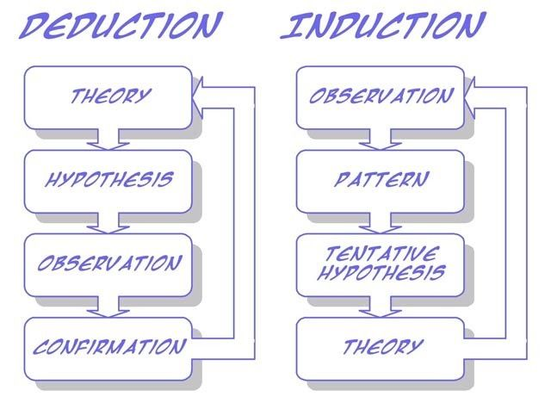

Slide 60
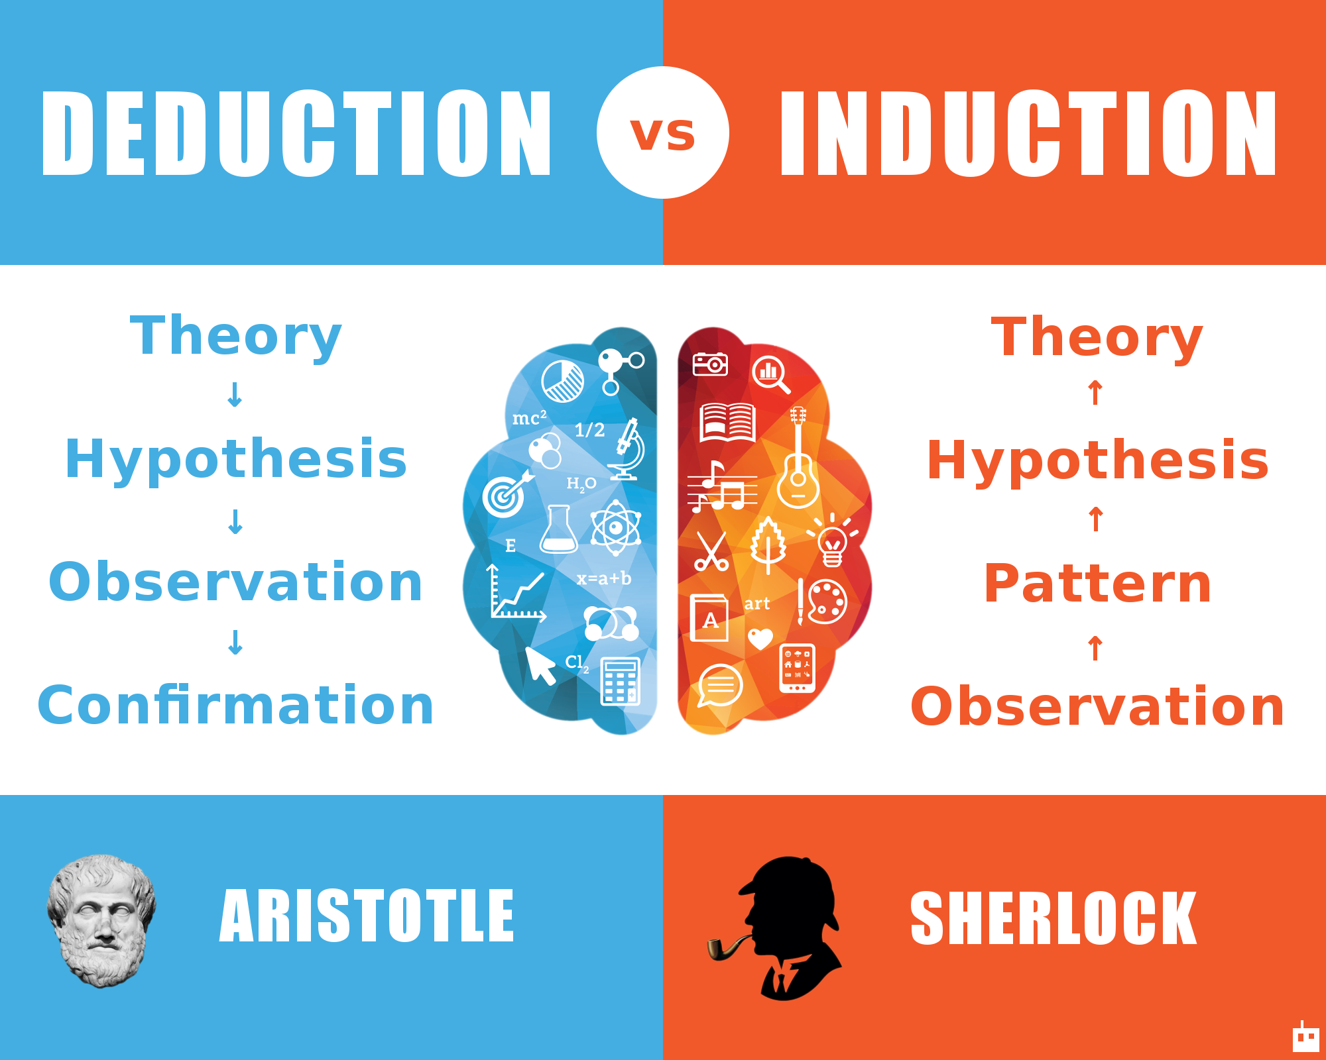

Slide 61
Three Questions to ask Before Correcting the Error
Is the cause of the bug reproduced in another part of the program?
Similar errors may be occurring in other parts of the program
What next bug might be introduced by the fix that I’m about to make?
The source code (and even the design) should be studied to assess the coupling of logic and data structures related to the fix
What could we have done to prevent this bug in the first place?
This is the first step toward software quality assurance
By correcting the process as well as the product, the bug will be removed from the current program and may be eliminated from all future programs
☺

Slide 62
Software Testing Techniques
Testing fundamentals
White-box testing
Black-box testing
Object-oriented testing methods

Slide 63
Characteristics of Testable Software
Operable
The better it works (i.e., better quality), the easier it is to test
Observable
Incorrect output is easily identified; internal errors are automatically detected
Controllable
The states and variables of the software can be controlled directly by the tester
Decomposable
The software is built from independent modules that can be tested independently
(more on next slide)

Slide 64
Characteristics of Testable Software (continued)
Simple
The program should exhibit functional, structural, and code simplicity
Stable
Changes to the software during testing are infrequent and do not invalidate existing tests
Understandable
The architectural design is well understood; documentation is available and organized

Slide 65
Test Characteristics
A good test has a high probability of finding an error
The tester must understand the software and how it might fail
A good test is not redundant
Testing time is limited; one test should not serve the same purpose as another test
A good test should be “best of breed”
Tests that have the highest likelihood of uncovering a whole class of errors should be used
A good test should be neither too simple nor too complex
Each test should be executed separately; combining a series of tests could cause side effects and mask certain errors

Slide 66
Two Unit Testing Techniques
Black-box testing
Knowing the specified function that a product has been designed to perform, test to see if that function is fully operational and error free
Includes tests that are conducted at the software interface
Not concerned with internal logical structure of the software
White-box testing
Knowing the internal workings of a product, test that all internal operations are performed according to specifications and all internal components have been exercised
Involves tests that concentrate on close examination of procedural detail
Logical paths through the software are tested
Test cases exercise specific sets of conditions and loops

Slide 67
White-box Testing

Slide 68
White-box Testing
Uses the control structure part of component-level design to derive the test cases
These test cases
Guarantee that all independent paths within a module have been exercised at least once
Exercise all logical decisions on their true and false sides
Execute all loops at their boundaries and within their operational bounds
Exercise internal data structures to ensure their validity
“Bugs lurk in corners and congregate at boundaries”

Slide 69
Basis Path Testing
White-box testing technique proposed by Tom McCabe
Enables the test case designer to derive a logical complexity measure of a procedural design
Uses this measure as a guide for defining a basis set of execution paths
Test cases derived to exercise the basis set are guaranteed to execute every statement in the program at least one time during testing

Slide 70
Flow Graph Notation
A circle in a graph represents a node, which stands for a sequence of one or more procedural statements
A node containing a simple conditional expression is referred to as a predicate node
Each compound condition in a conditional expression containing one or more Boolean operators (e.g., and, or) is represented by a separate predicate node
A predicate node has two edges leading out from it (True and False)
An edge, or a link, is a an arrow representing flow of control in a specific direction
An edge must start and terminate at a node
An edge does not intersect or cross over another edge
Areas bounded by a set of edges and nodes are called regions
When counting regions, include the area outside the graph as a region, too

Slide 71
Flow Graph Example
FLOW CHART
FLOW GRAPH
0
0
R4
1
1
2
2
3
R3
3
6
4
6
4
R2
7
8
5
R1
7
8
5
9
9
11
10
11
10

Slide 72
Independent Program Paths
Defined as a path through the program from the start node until the end node that introduces at least one new set of processing statements or a new condition (i.e., new nodes)
Must move along at least one edge that has not been traversed before by a previous path
Basis set for flow graph on previous slide
Path 1: 0-1-11
Path 2: 0-1-2-3-4-5-10-1-11
Path 3: 0-1-2-3-6-8-9-10-1-11
Path 4: 0-1-2-3-6-7-9-10-1-11
The number of paths in the basis set is determined by the cyclomatic complexity

Slide 73
Cyclomatic Complexity
Provides a quantitative measure of the logical complexity of a program
Defines the number of independent paths in the basis set
Provides an upper bound for the number of tests that must be conducted to ensure all statements have been executed at least once
Can be computed three ways
The number of regions
V(G) = E – N + 2, where E is the number of edges and N is the number of nodes in graph G
V(G) = P + 1, where P is the number of predicate nodes in the flow graph G
Results in the following equations for the example flow graph
Number of regions = 4
V(G) = 14 edges – 12 nodes + 2 = 4
V(G) = 3 predicate nodes + 1 = 4

Slide 74
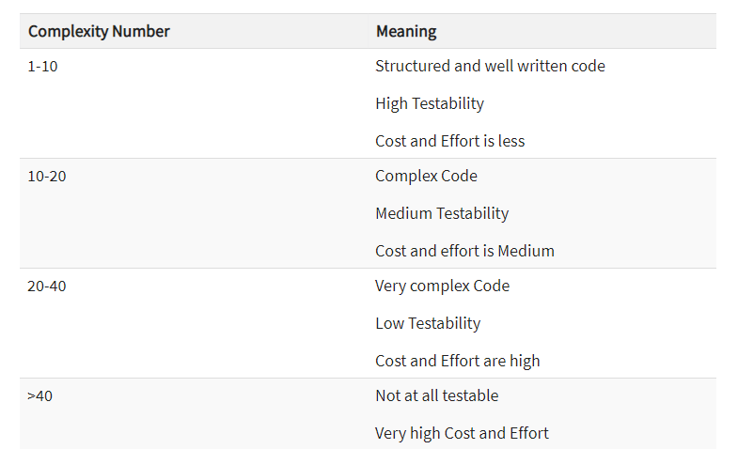

Slide 75
Deriving the Basis Set and Test Cases
Using the design or code as a foundation, draw a corresponding flow graph
Determine the cyclomatic complexity of the resultant flow graph
Determine a basis set of linearly independent paths
Prepare test cases that will force execution of each path in the basis set

Slide 76
A Second Flow Graph Example
3
1 int functionY(void)
2 {
3 int x = 0;
4 int y = 19;
5 A: x++;
6 if (x > 999)
7 goto D;
8 if (x % 11 == 0)
9 goto B;
10 else goto A;
11 B: if (x % y == 0)
12 goto C;
13 else goto A;
14 C: printf("%d\n", x);
15 goto A;
16 D: printf("End of list\n");
17 return 0;
18 }
4
5
6
8
7
10
9
16
11
17
13
12
14
15

Slide 77
A Sample Function to Diagram and Analyze
1 int functionZ(int y)
2 {
3 int x = 0;
4 while (x <= (y * y))
5 {
6 if ((x % 11 == 0) &&
7 (x % y == 0))
8 {
9 printf(“%d”, x);
10 x++;
11 } // End if
12 else if ((x % 7 == 0) ||
13 (x % y == 1))
14 {
15 printf(“%d”, y);
16 x = x + 2;
} // End else
18 printf(“\n”);
19 } // End while
20 printf("End of list\n");
21 return 0;
22 } // End functionZ

Slide 78
A Sample Function to Diagram and Analyze
1 int functionZ(int y)
2 {
3 int x = 0;
4 while (x <= (y * y))
5 {
6 if ((x % 11 == 0) &&
7 (x % y == 0))
8 {
9 printf(“%d”, x);
10 x++;
11 } // End if
12 else if ((x % 7 == 0) ||
13 (x % y == 1))
14 {
15 printf(“%d”, y);
16 x = x + 2;
} // End else
18 printf(“\n”);
19 } // End while
20 printf("End of list\n");
21 return 0;
22 } // End functionZ
3
4
6
7
9
12
13
10
15
16
18
20
21

Slide 79
Loop Testing - General
A white-box testing technique that focuses exclusively on the validity of loop constructs
Four different classes of loops exist
Simple loops
Nested loops
Concatenated loops
Unstructured loops
Testing occurs by varying the loop boundary values
Examples: for (i = 0; i < MAX_INDEX; i++) while (currentTemp >= MINIMUM_TEMPERATURE)

Slide 80
Testing of Simple Loops
Skip the loop entirely
Only one pass through the loop
Two passes through the loop
m passes through the loop, where m < n
n –1, n, n + 1 passes through the loop
‘n’ is the maximum number of allowable passes through the loop

Slide 81
Testing of Nested Loops
Start at the innermost loop; set all other loops to minimum values
Conduct simple loop tests for the innermost loop while holding the outer loops at their minimum iteration parameter values; add other tests for out-of-range or excluded values
Work outward, conducting tests for the next loop, but keeping all other outer loops at minimum values and other nested loops to “typical” values
Continue until all loops have been tested

Slide 82
Testing of Concatenated Loops
For independent loops, use the same approach as for simple loops
Otherwise, use the approach applied for nested loops

Slide 83
Testing of Unstructured Loops
Redesign the code to reflect the use of structured programming practices
Depending on the resultant design, apply testing for simple loops, nested loops, or concatenated loops

Slide 84
Black-box Testing

Slide 85
Black-box Testing
Complements white-box testing by uncovering different classes of errors
Focuses on the functional requirements and the information domain of the software
Used during the later stages of testing after white box testing has been performed
The tester identifies a set of input conditions that will fully exercise all functional requirements for a program
The test cases satisfy the following:
Reduce, by a count greater than one, the number of additional test cases that must be designed to achieve reasonable testing
Tell us something about the presence or absence of classes of errors, rather than an error associated only with the specific task at hand

Slide 86
Black-box Testing Categories
Incorrect or missing functions
Interface errors
Errors in data structures or external data base access
Behavior or performance errors
Initialization and termination errors

Slide 87
Questions answered by Black-box Testing
How is functional validity tested?
How are system behavior and performance tested?
What classes of input will make good test cases?
Is the system particularly sensitive to certain input values?
How are the boundary values of a data class isolated?
What data rates and data volume can the system tolerate?
What effect will specific combinations of data have on system operation?

Slide 88
Equivalence Partitioning
A black-box testing method that divides the input domain of a program into classes of data from which test cases are derived
An ideal test case single-handedly uncovers a complete class of errors, thereby reducing the total number of test cases that must be developed
Test case design is based on an evaluation of equivalence classes for an input condition
An equivalence class represents a set of valid or invalid states for input conditions
From each equivalence class, test cases are selected so that the largest number of attributes of an equivalence class are exercise at once

Slide 89
Guidelines for Defining Equivalence Classes
If an input condition specifies a range, one valid and two invalid equivalence classes are defined
Input range: 1 – 10 Eq classes: {1..10}, {x < 1}, {x > 10}
If an input condition requires a specific value, one valid and two invalid equivalence classes are defined
Input value: 250 Eq classes: {250}, {x < 250}, {x > 250}
If an input condition specifies a member of a set, one valid and one invalid equivalence class are defined
Input set: {-2.5, 7.3, 8.4} Eq classes: {-2.5, 7.3, 8.4}, {any other x}
If an input condition is a Boolean value, one valid and one invalid class are define
Input: {true condition} Eq classes: {true condition}, {false condition}

Slide 90
Boundary Value Analysis
A greater number of errors occur at the boundaries of the input domain rather than in the "center"
Boundary value analysis is a test case design method that complements equivalence partitioning
It selects test cases at the edges of a class
It derives test cases from both the input domain and output domain

Slide 91
Guidelines for Boundary Value Analysis
1. If an input condition specifies a range bounded by values a and b, test cases should be designed with values a and b as well as values just above and just below a and b
2. If an input condition specifies a number of values, test case should be developed that exercise the minimum and maximum numbers. Values just above and just below the minimum and maximum are also tested
Apply guidelines 1 and 2 to output conditions; produce output that reflects the minimum and the maximum values expected; also test the values just below and just above
If internal program data structures have prescribed boundaries (e.g., an array), design a test case to exercise the data structure at its minimum and maximum boundaries

Slide 92
Object-Oriented Testing Methods

Slide 93
Introduction
It is necessary to test an object-oriented system at a variety of different levels
The goal is to uncover errors that may occur as classes collaborate with one another and subsystems communicate across architectural layers
Testing begins "in the small" on methods within a class and on collaboration between classes
As class integration occurs, use-based testing and fault-based testing are applied
Finally, use cases are used to uncover errors during the software validation phase
Conventional test case design is driven by an input-process-output view of software
Object-oriented testing focuses on designing appropriate sequences of methods to exercise the states of a class

Slide 94
Grey Box Testing
The different types of test cases that can be designed for testing object-oriented programs are called grey box test cases. Some of the important types of grey box testing are −
State model based testing − This encompasses state coverage, state transition coverage, and state transition path coverage.
Use case based testing − Each scenario in each use case is tested.
Class diagram based testing − Each class, derived class, associations, and aggregations are tested.
Sequence diagram based testing − The methods in the messages in the sequence diagrams are tested

Slide 95
Testing Implications for Object-Oriented Software
Because attributes and methods are encapsulated in a class, testing methods from outside of a class is generally unproductive
Testing requires reporting on the state of an object, yet encapsulation can make this information somewhat difficult to obtain
Built-in methods should be provided to report the values of class attributes in order to get a snapshot of the state of an object
Inheritance requires retesting of each new context of usage for a class
If a subclass is used in an entirely different context than the super class, the super class test cases will have little applicability and a new set of tests must be designed

Slide 96
Applicability of Conventional Testing Methods
White-box testing can be applied to the operations defined in a class
Basis path testing and loop testing can help ensure that every statement in an method has been tested
Black-box testing methods are also appropriate
Use cases can provide useful input in the design of black-box tests

Slide 97
Fault-based Testing
The objective in fault-based testing is to design tests that have a high likelihood of uncovering plausible faults
Fault-based testing begins with the analysis model
The tester looks for plausible faults (i.e., aspects of the implementation of the system that may result in defects)
To determine whether these faults exist, test cases are designed to exercise the design or code
If the analysis and design models can provide insight into what is likely to go wrong, then fault-based testing can find a significant number of errors

Slide 98
Fault-based Testing (continued)
Integration testing looks for plausible faults in method calls or message connections (i.e., client/server exchange)
Three types of faults are encountered in this context
Unexpected result
Wrong method or message used
Incorrect invocation
The behavior of a method must be examined to determine the occurrence of plausible faults as methods are invoked
Testing should exercise the attributes of an object to determine whether proper values occur for distinct types of object behavior
The focus of integration testing is to determine whether errors exist in the calling code, not the called code

Slide 99
Fault-based Testing vs. Scenario-based Testing
Fault-based testing misses two main types of errors
Incorrect specification: subsystem doesn't do what the user wants
Interactions among subsystems: behavior of one subsystem creates circumstances that cause another subsystem to fail
A solution to this problem is scenario-based testing
It concentrates on what the user does, not what the product does
This means capturing the tasks (via use cases) that the user has to perform, then applying them as tests
Scenario-based testing tends to exercise multiple subsystems in a single test

Slide 100
Random Order Testing (at the Class Level)
Certain methods in a class may constitute a minimum behavioral life history of an object (e.g., open, seek, read, close); consequently, they may have implicit order dependencies or expectations designed into them
Using the methods for a class, a variety of method sequences are generated randomly and then executed
The goal is to detect these order dependencies or expectations and make appropriate adjustments to the design of the methods

Slide 101
Partition Testing (at the Class Level)
Similar to equivalence partitioning for conventional software
Methods are grouped based on one of three partitioning approaches
State-based partitioning categorizes class methods based on their ability to change the state of the class
Tests are designed in a way that exercise methods that change state and those that do not change state
Attribute-based partitioning categorizes class methods based on the attributes that they use
Methods are partitioned into those that read an attribute, modify an attribute, or do not reference the attribute at all
Category-based partitioning categorizes class methods based on the generic function that each performs
Example categories are initialization methods, computational methods, and termination methods

Slide 102
Multiple Class Testing
Class collaboration testing can be accomplished by applying random testing, partition testing, scenario-based testing and behavioral testing
The following sequence of steps can be used to generate multiple class random test cases
For each client class, use the list of class methods to generate a series of random test sequences; use these methods to send messages to server classes
For each message that is generated, determine the collaborator class and the corresponding method in the server object
For each method in the server object (invoked by messages from the client object), determine the messages that it transmits
For each of these messages, determine the next level of methods that are invoked and incorporate these into the test sequence

Slide 103
Tests Derived from Behavior Models
The state diagram for a class can be used to derive a sequence of tests that will exercise the dynamic behavior of the class and the classes that collaborate with it
The test cases should be designed to achieve coverage of all states
Method sequences should cause the object to transition through all allowable states
More test cases should be derived to ensure that all behaviors for the class have been exercised based on the behavior life history of the object
The state diagram can be traversed in a "breadth-first" approach by exercising only a single transition at a time
When a new transition is to be tested, only previously tested transitions are used
☺

